Slide 1
Critique Report on Sprint I
Attendance Tracking System team

Slide 2
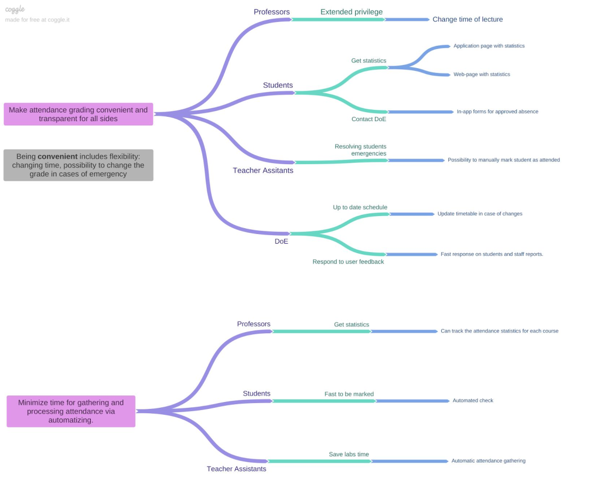

Slide 3
Artifact 3. Impact map. Good things
While refining redundancy from impact map was removed
All necessary actors are presented on a map
All features affect the main goals

Slide 4
Artifact 3. Impact map. “Can be better” things
Not clear why map is split in two different parts with different goals
Not clear how goals correspond to SMART criteria
Negative impacts are not considered

Slide 5

Write explicitly how goals conform to SMART criteria
Try to consider negative impacts as well

Slide 6
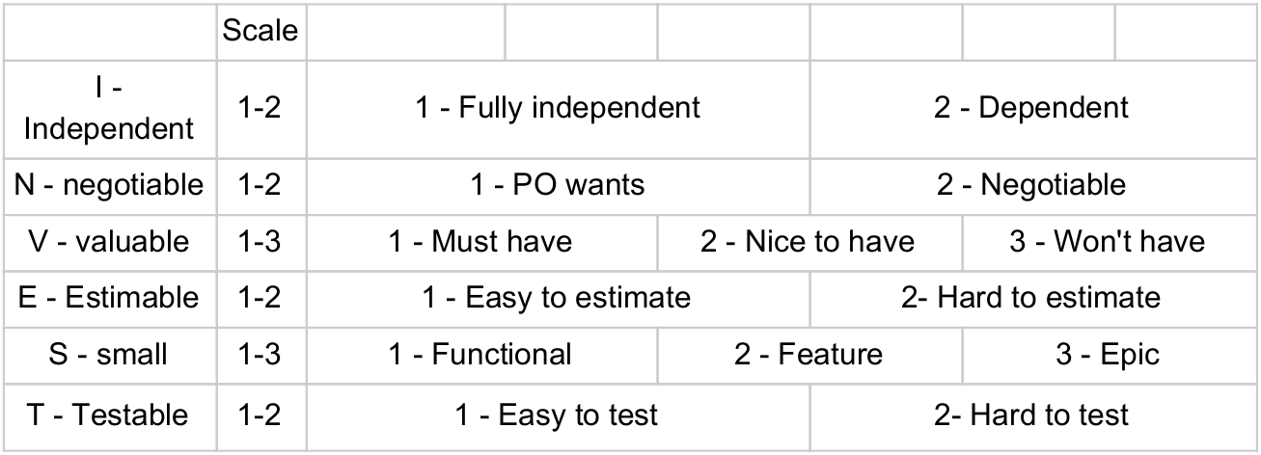

Slide 7
Artifact 4. INVEST table. Good things
The scales are consistent in terms of numbers
Basically everything is clear

Slide 8
Artifact 4. INVEST table. “Can be better” things
We liked it. You did well. No bad things, no advices :)

Slide 9
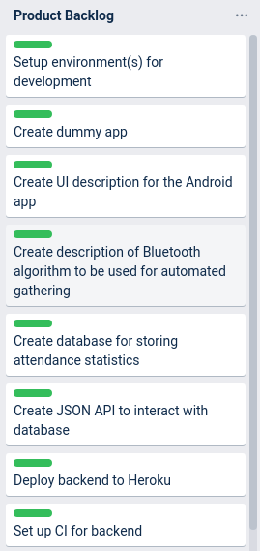
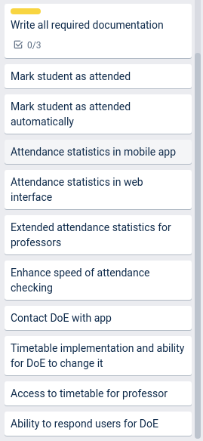

Slide 10
Artifact 4. Product backlog. Good things
Product backlog initially lacked number of user stories. Good thing, they were added after refining

Slide 11
Artifact 4. Product backlog. “Can be better” things
Team did not provide INVEST criteria for new user stories

Slide 12
Include INVEST estimation for new user stories in the backlog

Slide 13
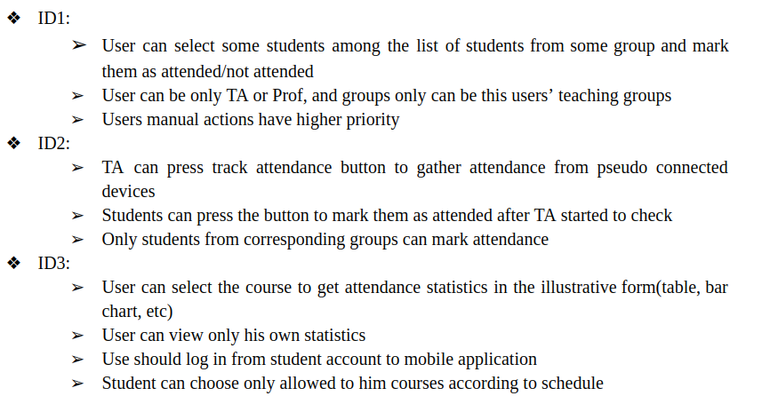

Slide 14
Artifact 5. Acceptance criteria. Good things
All criterias are well detailed

Slide 15
Artifact 5. Acceptance criteria. “Can be better” things
All acceptance criterias do not comply to the given-when-then format

Slide 16
Change the format of acceptance criterias

Slide 17
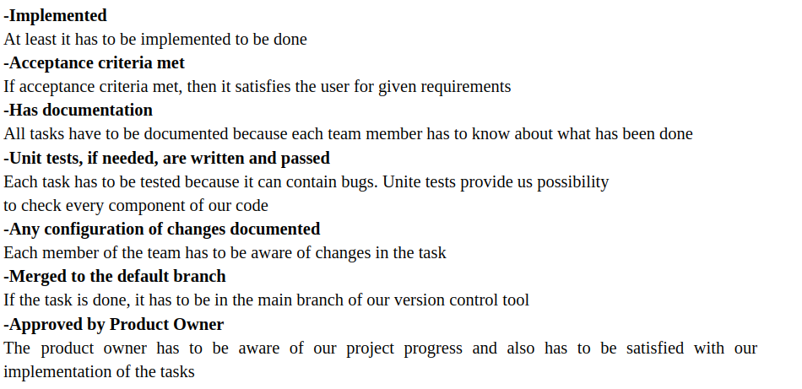

Slide 18
Artifact 5. Definition of done. Good things
Product owner’s approval was considered
DoD enhances team communication

Slide 19
Artifact 5. Definition of done. “Can be better” things
In unit testing “where needed” part is ambiguous
The same is for “configuration of changes”
“Implemented” criteria is redundant

Slide 20
Remove “where needed” and “Implemented” criterias
Instead of notifying all team members about changes in code, better to add “Code reviewed by other team members”

Slide 21
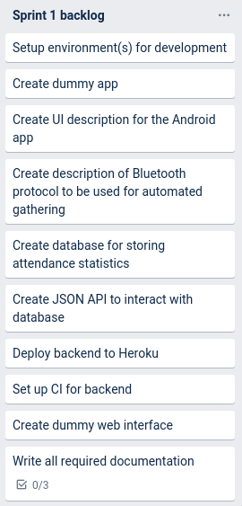
Sprint I
Sprint backlog was refined, and all items were implemented
PM board is consistent and visual
Reflection material was provided
Goal was reached

Slide 22


